Slide 1
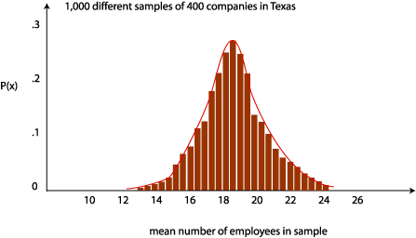
Week 6: Central limit theorem and confidence intervals
Geog4300: Shannon

Slide 2
This week
Z/t scores
Central limit theorem
Confidence intervals
Sampling
Lab 3 will be available after class on Thursday. Due date: October 23 (Thursday)
Thoughts/reflections from Lab 2?

Slide 3
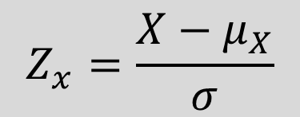

Z (and t) scores
How many standard deviations is an observation from the mean?
These can also be called standardized anomalies.
$$Z_{x}>1$$
${ Z}_{x}$< -1
How would you interpret these values?

Slide 4

Z (and t) scores
How many standard deviations is an observation from the mean?
For a variable with a mean of 23 and a s.d. of 4, the z-score for 30 would be:
$$\frac{30 −23}{4}=1.75$$
What value would produce a z-score of negative 2?

Slide 5
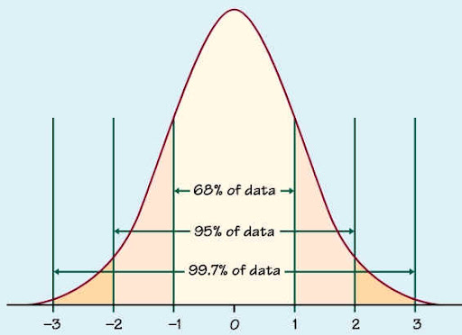
Z (and t) scores: Why do they matter?
They provide an easy way to compare data from different distributions (e.g. daytime and nighttime temperatures)
In a normal distribution, we can identify what percentage of observations fall within given range of Z scores.
Z scores of -1 to 1: 68% of observations
Z score of -1.75 to 1.75: 90% of observations
Z score of -1.96 to 1.96: 95% of observations

Slide 6
Data challenge!
Pick a variable from our county census dataset. Transform its values to z-scores in Excel. You’ll need to:
Calculate the mean and standard deviation for all observations
Subtract the mean and divide by standard deviation for all observations
How many counties are above 2? How many below -2? In what states/regions are these located?

Slide 7

The central limit theorem:
What’s the relationship between the mean of the sample population and the actual population?

Slide 8
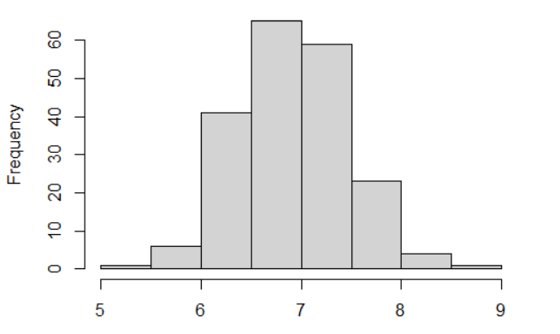

Central limit theorem: The distribution of sample means is normally distributed and centers around the population mean.
The actual mean is here somewhere!

Slide 9
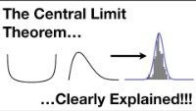

Slide 10
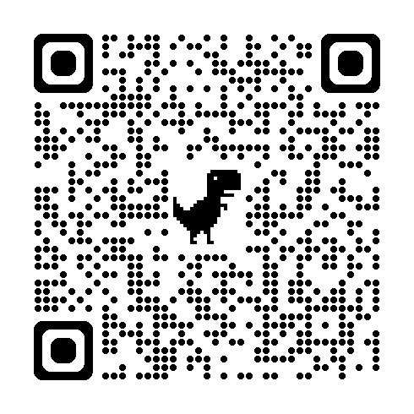
Let’s roll!
Roll your die 10 times. Put the results on this page:
Then do two more sets of 10 rolls (30 total rolls)

Slide 11
Identifying our terms
Samples: Each individual set of 10 dice rolls
Sample mean distribution: Just the mean values for each set of 10 dice rolls
Population: All possible means for of 10 dice rolls in the universe

Slide 12
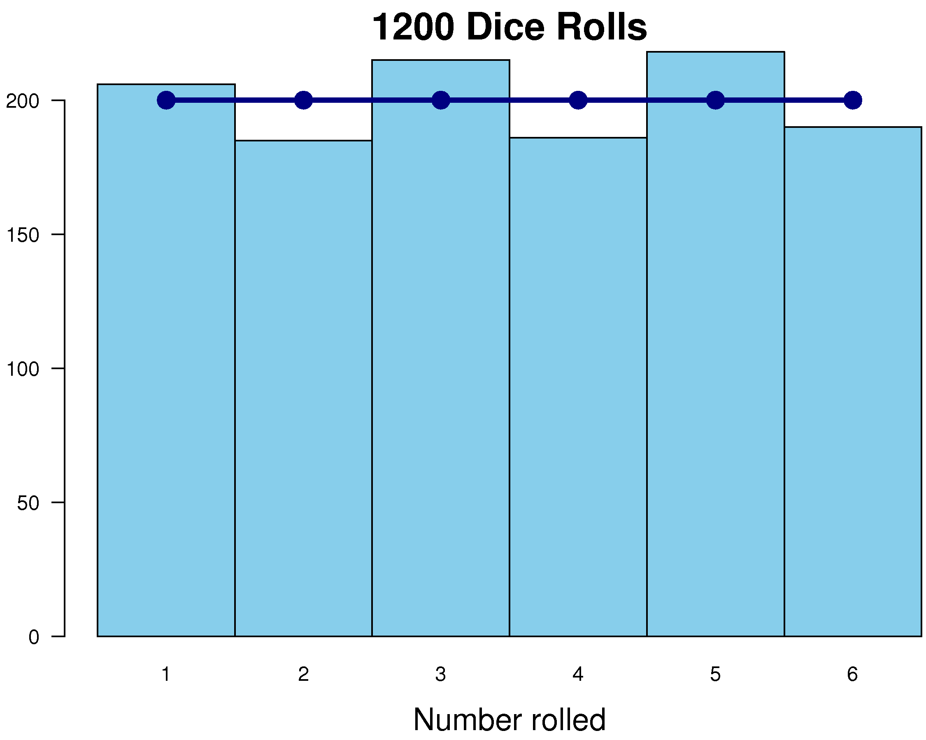
What’s the mean of the population?
Mean of two dice rolls: 3.5
Standard deviation: 1.7
How did the means of your three “samples” compare?

Slide 13
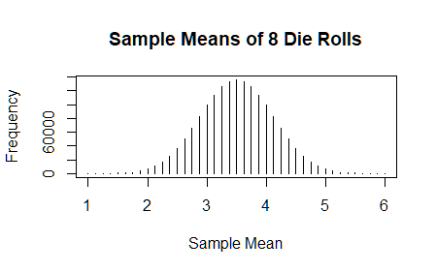
What’s the mean and standard deviation for our whole class’s rolls (the sample mean distribution)?
Mean of these means: 3.5
Standard deviation of these means: 0.5

Slide 14


Standard error
$$σ_{\overline{x}}=\frac{σ}{\sqrt{n}}$$
How many 10 dice roll samples did we create? What should our standard error be?
How many means fit within 1 standard error of the mean? Within 2 standard errors?
$σ$=standard deviation of sample or population

Slide 15
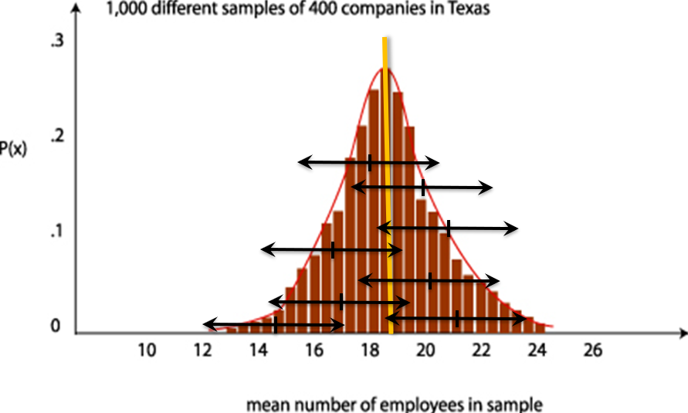
Confidence intervals

Slide 16

Confidence intervals
Three ingredients for a confidence interval:
Sample mean
Standard error
Z-score for the confidence interval
Margin of error = z-score * the standard error
Subtract and add this MOE to the sample mean
What’s the confidence interval for each of your three dice roll samples? How many include the actual mean of 7?
$$σ_{\overline{x}}=\frac{σ}{\sqrt{n}}$$

Slide 17
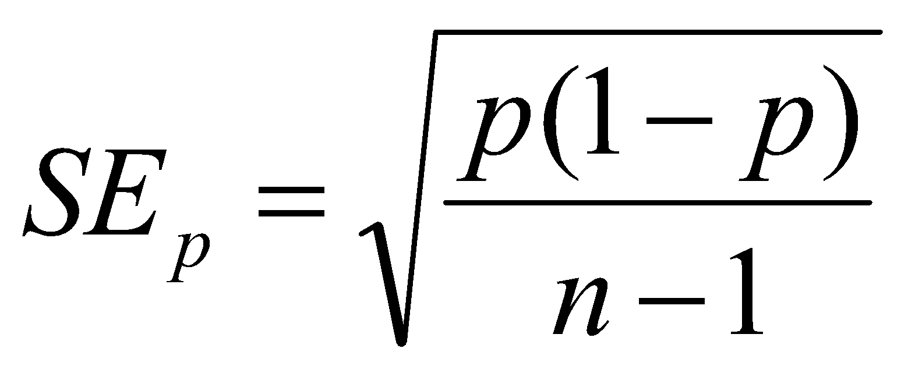
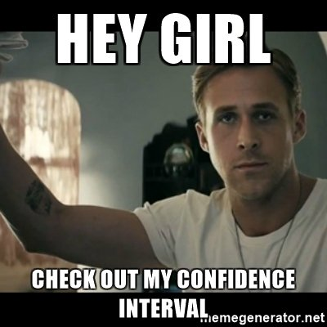
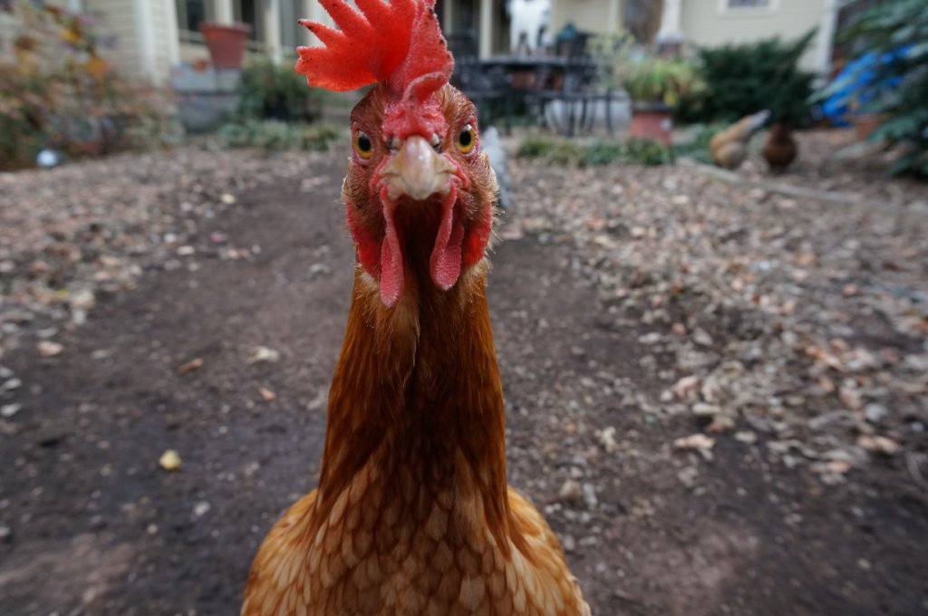
Confidence intervals for proportions
You asked 50 households in Athens if they keep chickens on their property. Three said they did. Create a confidence interval for the proportion of chicken owning households in the city.

Slide 18

Let’s talk about sampling!

Slide 19

Sample research question:
What are the most significant obstacles homeowners face in maintaining their homes? How does this vary by the homeowners’ age?

Slide 20
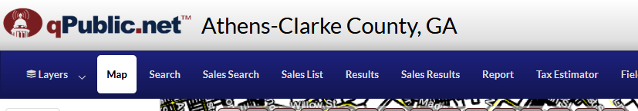
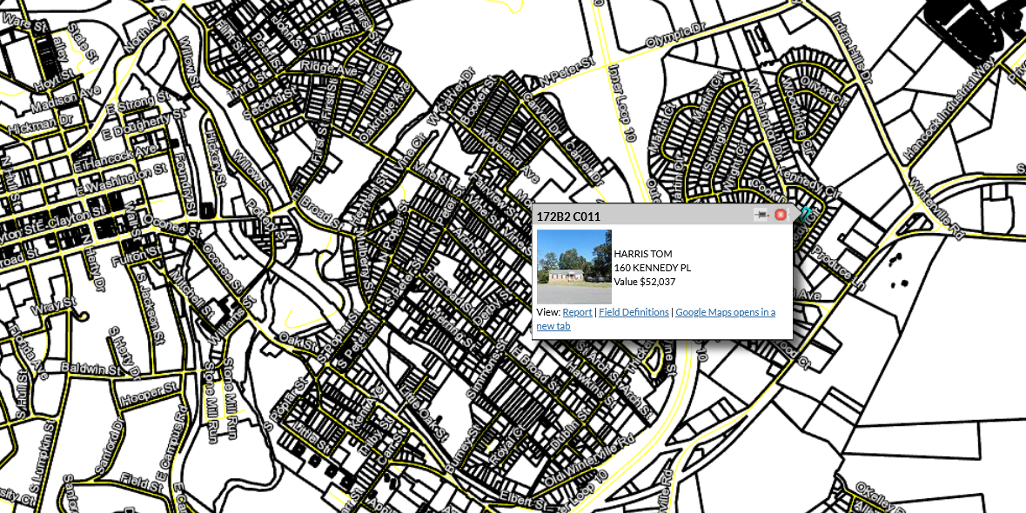
Sampling frame:
List of ALL possible households you could interview

Slide 21
Sampling strategy
Non-probability sample Convenience
Snowball
Quota
Probability sample
Random
Systematic
Stratified
Cluster

Slide 22

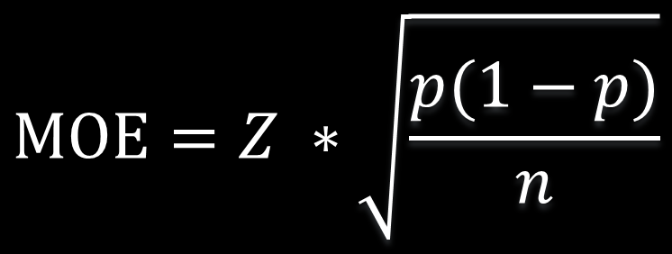
Sample size
$$MOE=Z ∗\sqrt{\frac{p(1−p)}{n}}$$
If the MOE for proportions is
Then we can compute sample size as
$$n=\frac{Z^{2}}{{MOE}^{2}}∗(p ∗\left(1−p\right))$$
We asked 20 homeowners if they were worried about losing their homes in the next year. Four said yes. What’s the confidence interval?
How big a sample would we need to get a margin of error of less than 1.5%?

